Slide 1


The Chatbot for Sadat Academy for Management Sciences
Sams-bot
Prepared by : Mazen Ibrahem
Mafdy Ashraf
Mohamed hany
Supervised by : Prof. Ghada Mostafa

Slide 2

Problem Description
Problem at finding accurate answers for the admission phase .
We work on that point on our Project and feed the Chatbot with the whole info of the Sadat Academy’s Admission phases.

Slide 3

Objective
We are willing to create an tool.
that could give the User any answer that related to the Academy and have the ability to update it’s Database to got an updatable Database

Slide 4

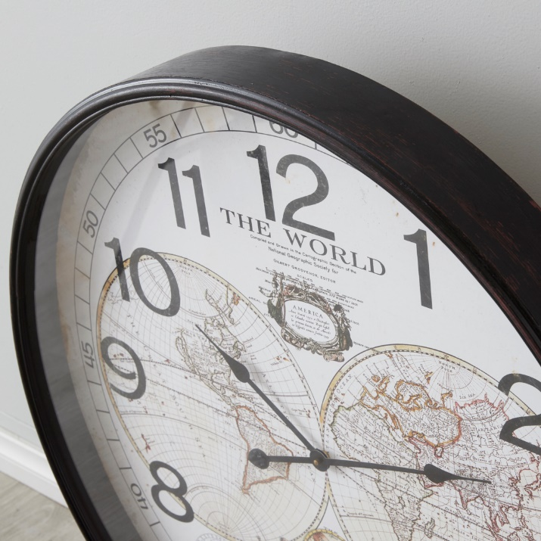


Advantages
Instant Responses
24/7 Availability
Availability to update the Data
Productivity

Slide 5


Users
Applicants
It Includes the out-comer that has any Inquiry at the Admission phases

Slide 6









Tools
Microsoft Excel
Adobe XD
Enterprise Architect
The Tools that we use to create “SAMS-Bot”
Microsoft Visio
Microsoft Access

Slide 7




Data / Requirements Gathering Technique
Interviews
Other Chat-bots
Feedbacks

Slide 8
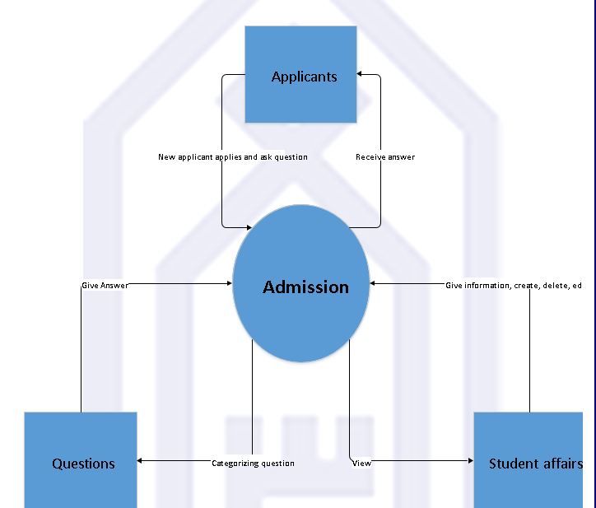
Diagrams
Context Diagram

Slide 9
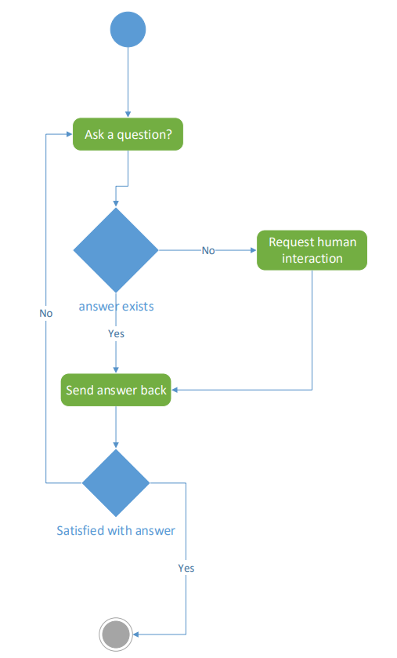
Diagrams
Activity Diagram

Slide 10
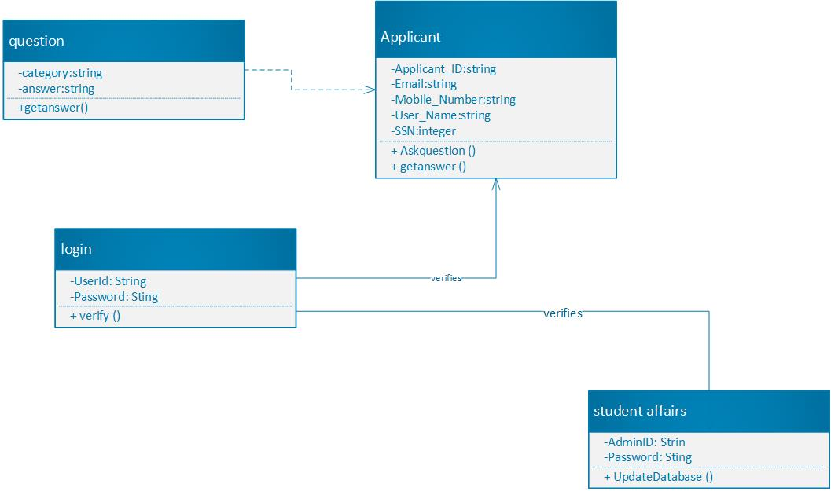
Diagrams
Class Diagram

Slide 11
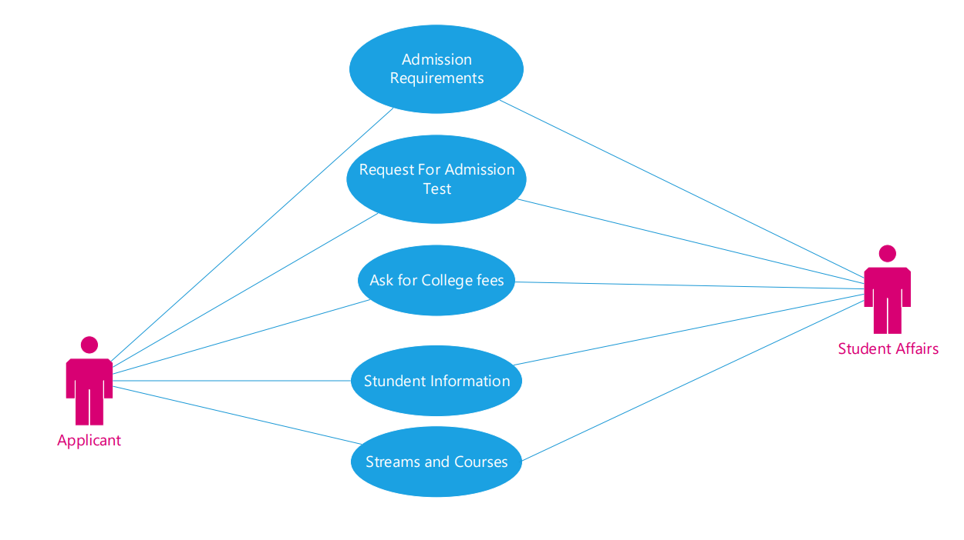
Diagrams
Use-case

Slide 12
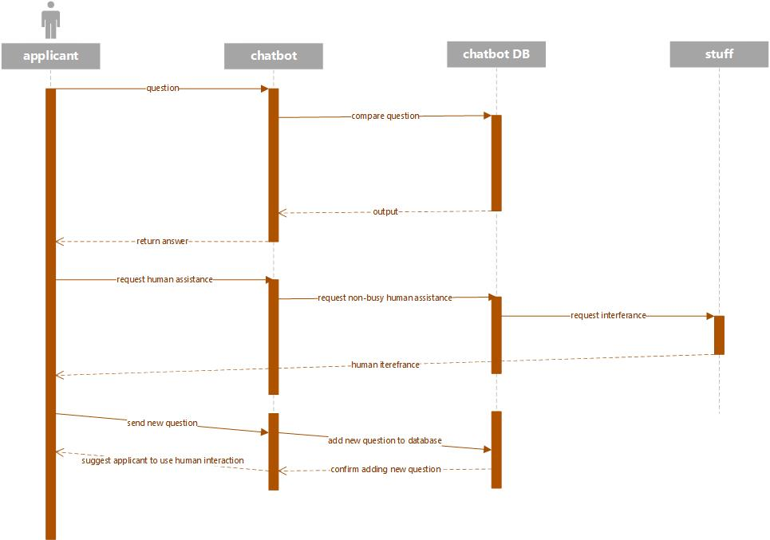
Diagrams
Sequence Diagram

Slide 13
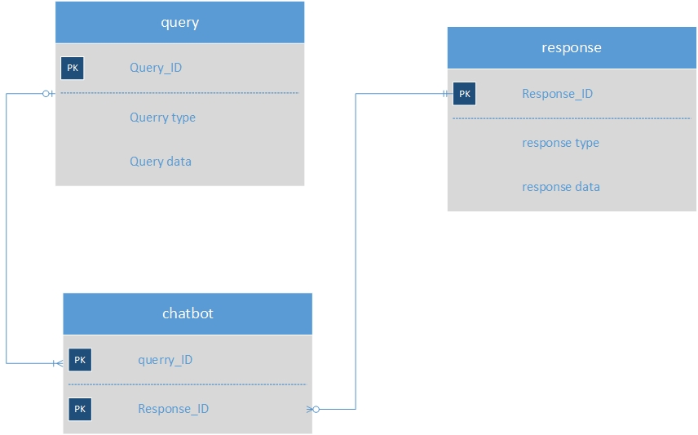
Diagrams
ERD

Slide 14
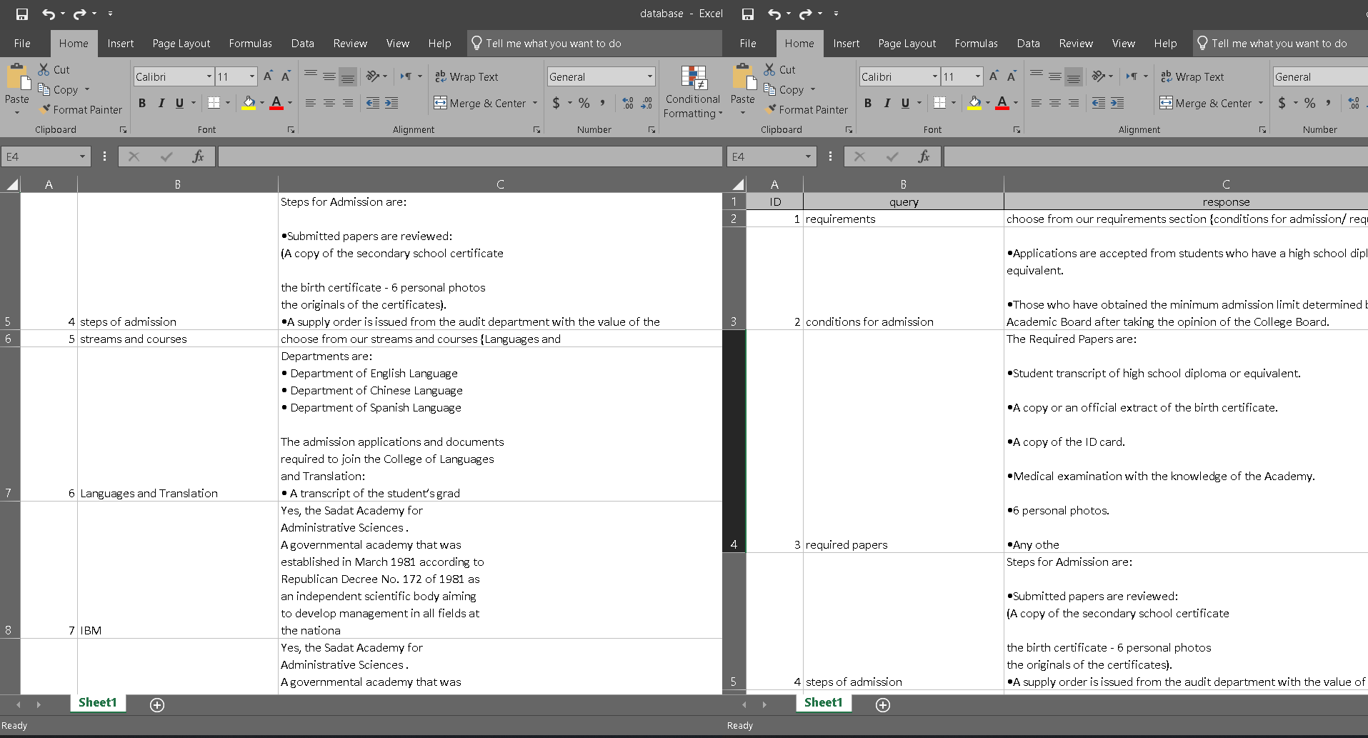
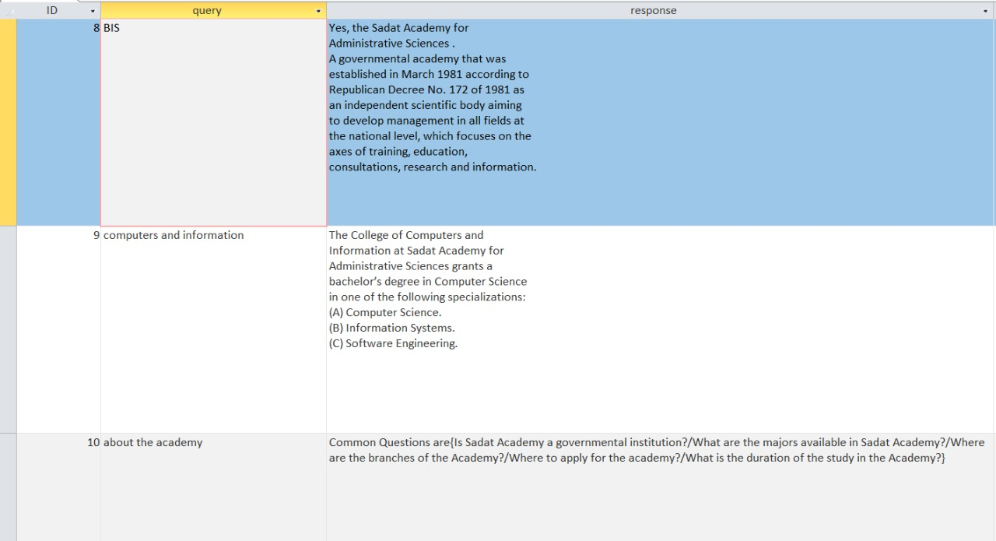
Diagrams
Database

Slide 15
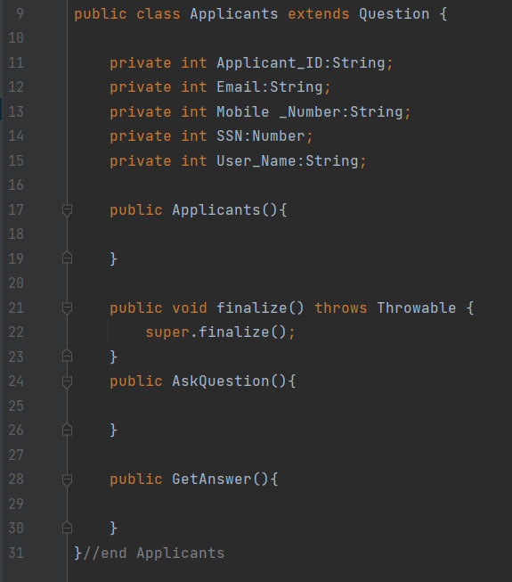
Coding Sample

Slide 16
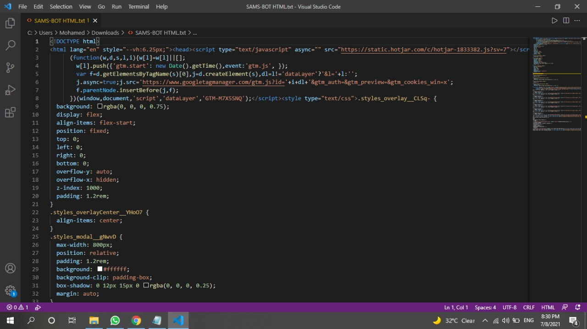
Coding Sample

Slide 17

Summary
Getting a New Customer Service Tool
By Applying this technology at the Academy website it will ease the ways of communication between the Academy and the Applicants

Slide 18

Thank You

